Slide 1
Managing Users in Alma
Yoel Kortick
Senior Librarian

Slide 2

Agenda
Staff User Roles for managing users
The Find and Manage Users page
Adding users
User Roles
Searching for, editing and deleting users

Slide 3
Staff User Roles for managing users

Slide 4
Staff User Roles for managing users
To manage users in Alma, the staff user must have at least one of the following roles:
  User Manager
  User Administrator
  Circulation Desk Manager
  Circulation Desk Operator

Slide 5
Staff User Roles for managing users

Slide 6
The Find and Manage Users page

Slide 7
The Find and Manage Users page
The staff user can manage users on the Find and Manage Users page
This page can be accessed at Admin > User Management > Manage Users
This page can also be accessed by searching for a user from the persistent search.

Slide 8
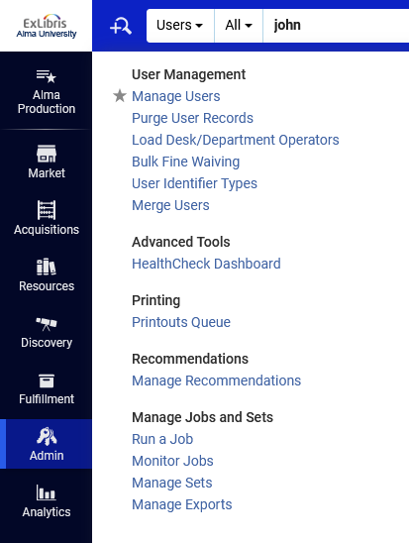
The Find and Manage Users page

Slide 9
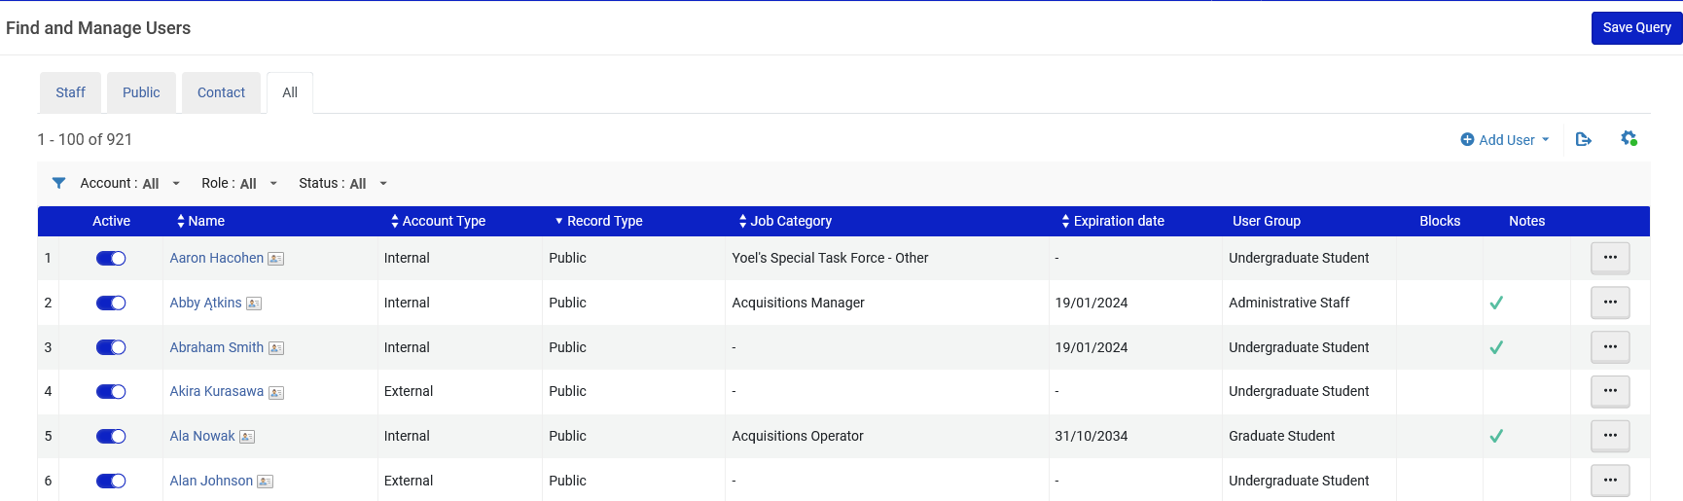
The Find and Manage Users page
Here we accessed the Find and Manage Users page via Admin > User Management > Manage Users

Slide 10
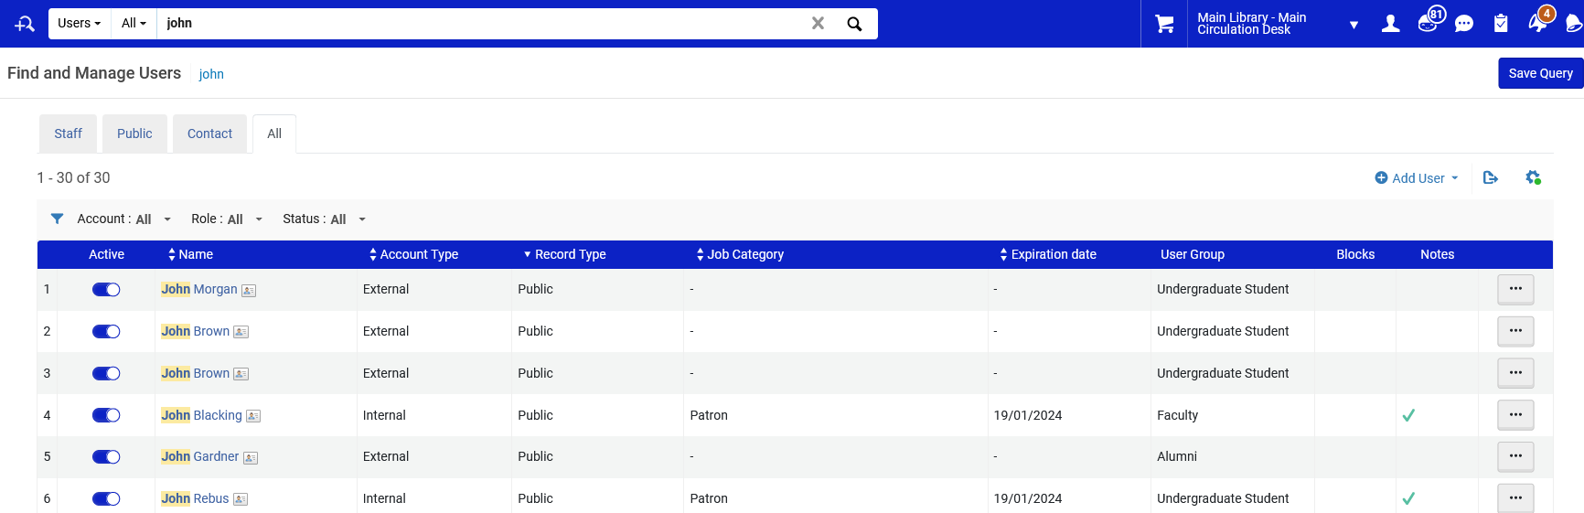
The Find and Manage Users page
Here we accessed the Find and Manage Users page via the persistent search

Slide 11
The Find and Manage Users page
The tabs Staff, Public, Contact, and All can be used to filter the user list according to user record type.
The filters Account, Role, and Status can be used to further filter the user list

Slide 12
The Find and Manage Users page
Regarding the filters Account, Role, and Status:
  Account filter – filters the list to display users with account "External", "Internal", "Internal with external authentication" or "All users".
  Role filter – filters the list to display only the users with a specific role.
  Status filter - filters the list to display users with status "All statuses", "Active and not expired" or "Not active or expired".

Slide 13
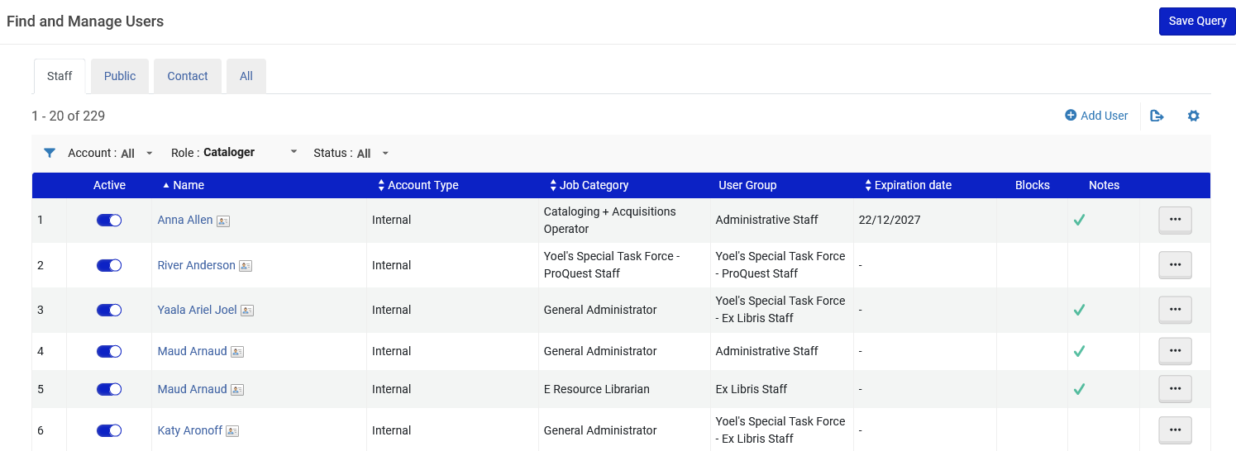
The Find and Manage Users page
For example: Here we have all users with record type "Staff" that have role "Cataloger"

Slide 14
The Find and Manage Users page
From the "Find and Manage Users" page it is possible to:
  Add Users
  Edit Users (typically required immediately after adding a new user).
  Delete Users (Can be done only by a staff user with role "User Manager" or "User Administrator")
We will now discuss "Adding Users"
Editing and deleting Users will be mentioned later in the section on Searching for, editing and deleting users

Slide 15
Adding users

Slide 16
Adding users
Users can be added to Alma via
  An Integration Profile of type "User" (this creates users of type "External" because they are created by and synchronized with an external system)
  An API (this can create users of type "External" or "Internal", and also update the user)
  Manually (this creates "Internal" users because they are handled internally)
In this presentation we will focus on the manual method.

Slide 17
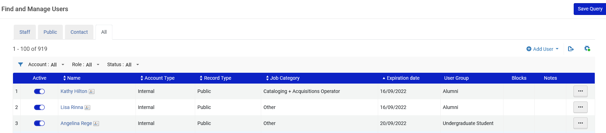
Adding users
To add a new user:
  On the Find and Manage Users page select Add User.

Slide 18
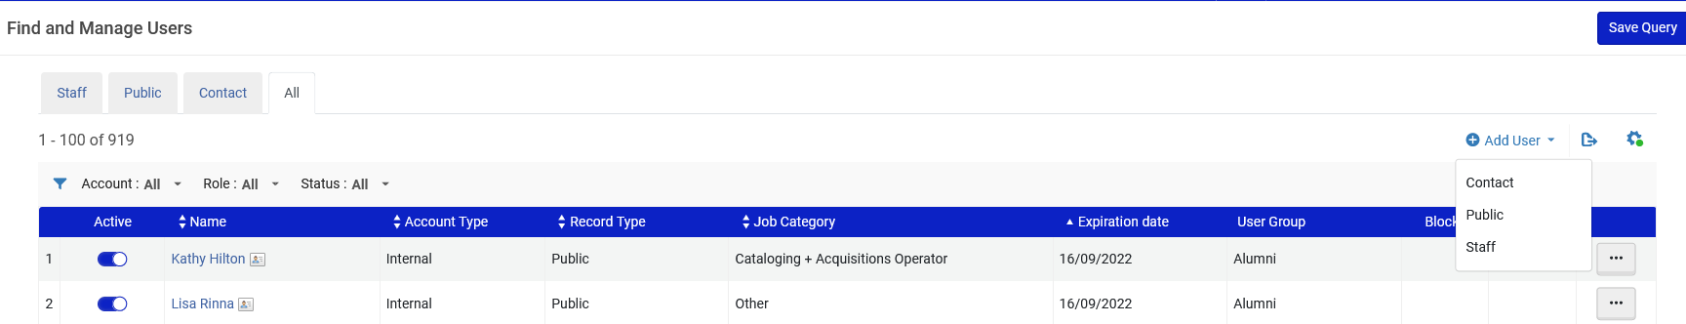
Adding users
If "Add User" is clicked while the staff user is focused on the "All" tab, then he or she will be requested to choose the record type:

Slide 19
Adding users
If "Add User" is clicked while the staff user is focused on the "Staff" tab, then the user will be created automatically as record type "Staff".
If "Add User" is clicked while the staff user is focused on the "Public" tab, then the user will be created automatically as record type "Public".
It is not recommended to create users of type "Contact" from the Find and Manage Users page. Users of record type "Contact" get automatically created when a "Contact" is added in a vendor record.

Slide 20
Adding users
After clicking "Add User" the "Quick User Management" screen opens.
User details such as name, primary identifier, user group, etc. need to be added here.
The fields on this screen are described in the table "Quick User Management Page Fields" at Adding Users.

Slide 21
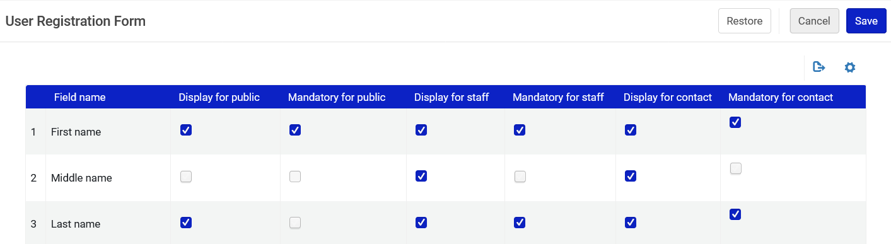
Adding users
Which fields will display for the user and which fields are mandatory for the user is configured at Configuration > User Management > User Details > User Registration Form.
Middle name will not display for Record Type "Public"
Last name is not mandatory for Record Type "Public"

Slide 22
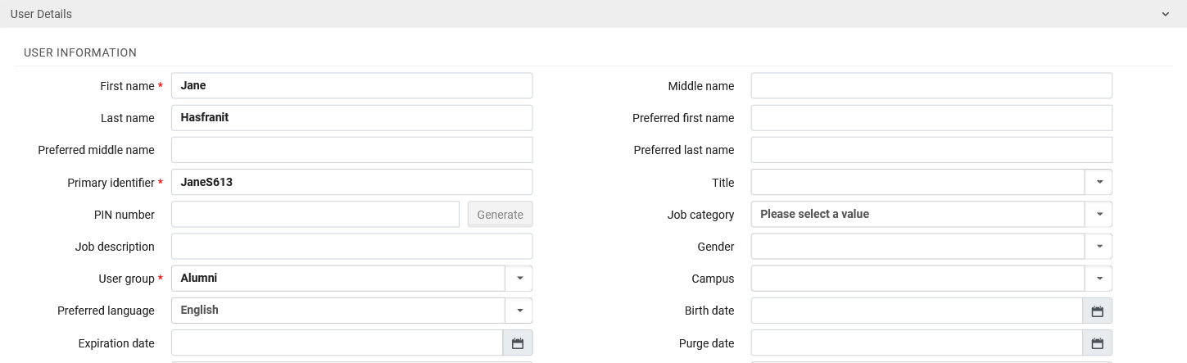
Adding users
Here we have filled in First name, Last name, Primary Identifier, User group, and Preferred language

Slide 23
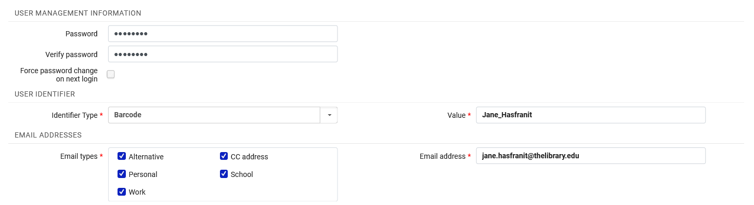
Adding users
Here have added the password, an additional identifier (barcode) and email.
Entering s password is relevant only for users of type “Internal”

Slide 24
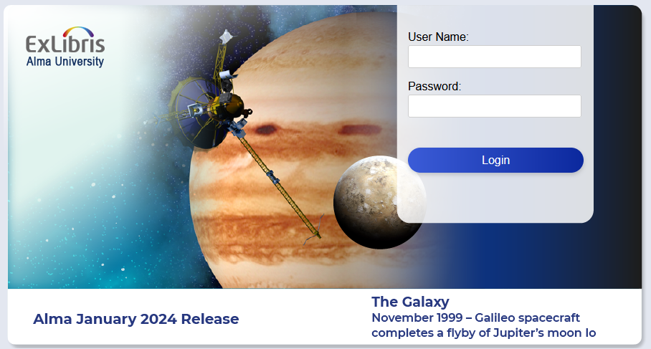
Adding users
When a staff user logs into Alma the "Primary Identifier" is used in the "User Name" field and the "Password" is used in the "Password"
Note: Authentication is a separate topic, and typically institutions handle this externally.

Slide 25
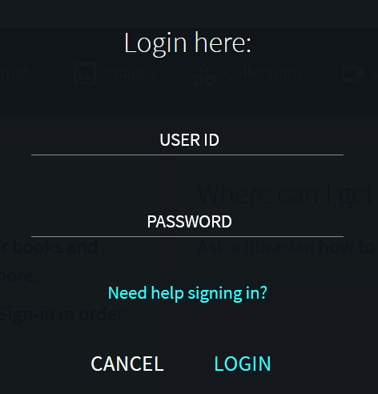
Adding users
When a user logs into Primo the "Primary Identifier" is used in the "User ID" field and the "Password" is used in the "Password"
Note: Authentication is a separate topic, and typically institutions handle this externally.

Slide 26
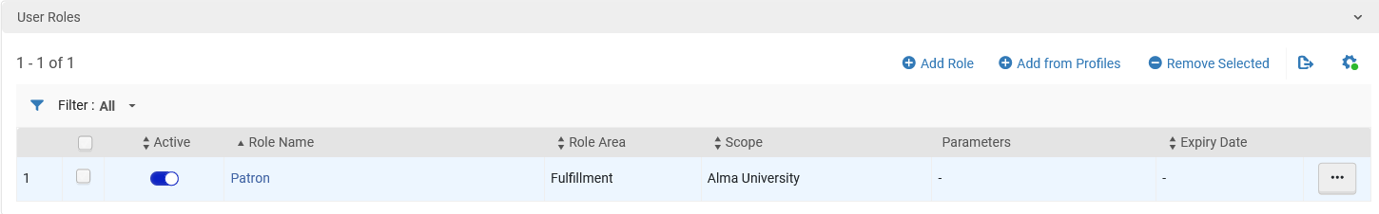
Adding users
After the general details of the user have been added the roles need to be added.
The "User Roles" section appears at the bottom of the "User Details" screen.

Slide 27
User Roles

Slide 28
User Roles
In Alma staff user and patrons are all in the same file (the same list of users).
What differentiates a patron from a staff user is the user roles he or she has.
A patron will have only role "Patron" .
A staff user will have the role "Patron" (if he or she wants to do patron activities such as loan and request) and also will have staff roles (such as "Cataloger" or "Fulfillment Manager").
For a list of all roles and description of each role see User Roles – Descriptions and Accessible Components

Slide 29
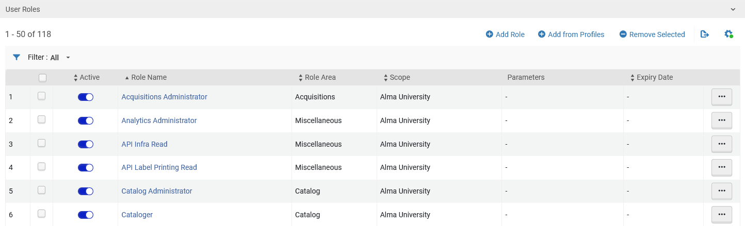
User Roles
These are sample roles of a staff user

Slide 30
User Roles
This is the role of a patron.
Note that it is possible to have multiple patron roles, each one with a different scope.

Slide 31
User Roles
To add a role, click "Add Role"

Slide 32
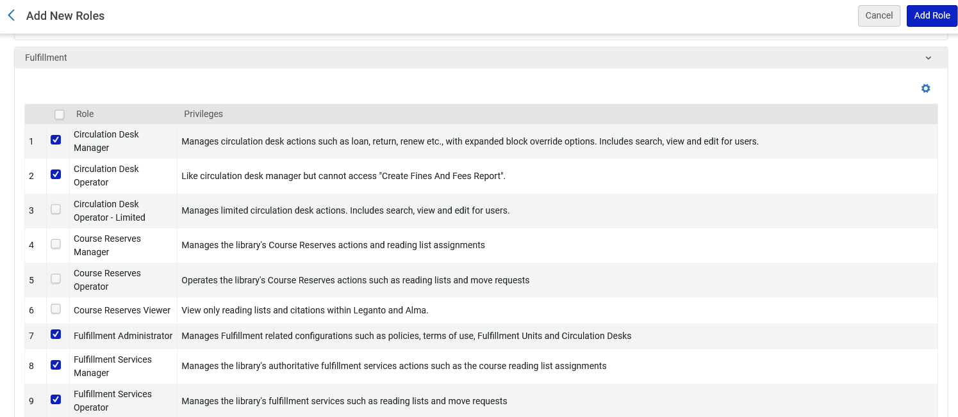
User Roles
Select desired roles and click "Add Role"

Slide 33
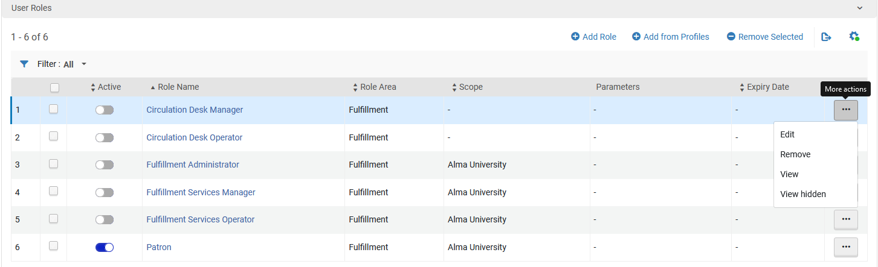
User Roles
Some roles require a "scope" and sometimes also a "Parameter" which can be added by editing the role.
Roles also need to be made "Active" by toggling the "Active" button or by editing the role.

Slide 34
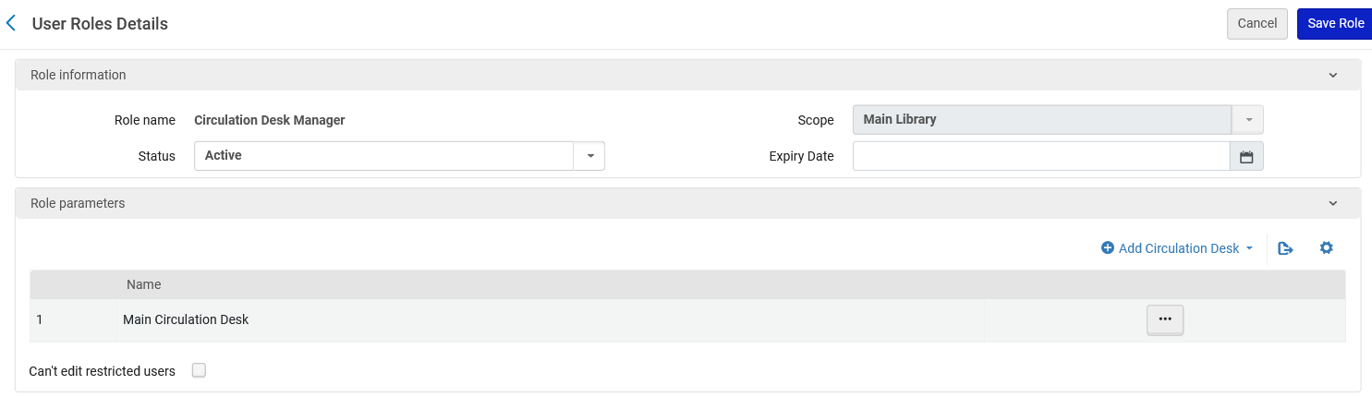
User Roles
Here for role "Circulation Desk manager" we have added a scope and role parameter.
We have also set the status to "Active".

Slide 35
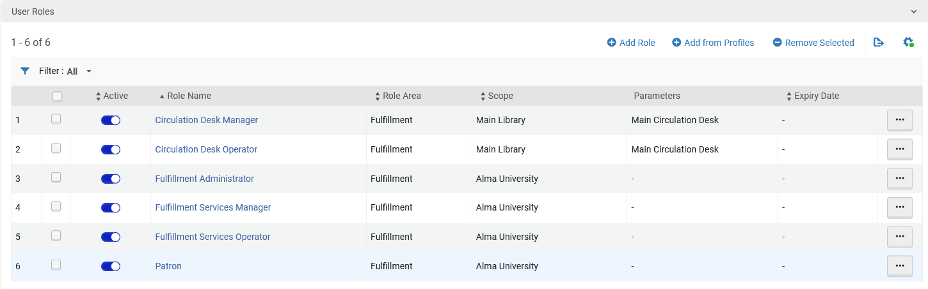
User Roles
Now all roles for this user are active and have necessary scopes and parameters

Slide 36
User Roles
It is also possible to add roles from profiles.
A profile is a predefined list of roles to be added all at once.

Slide 37
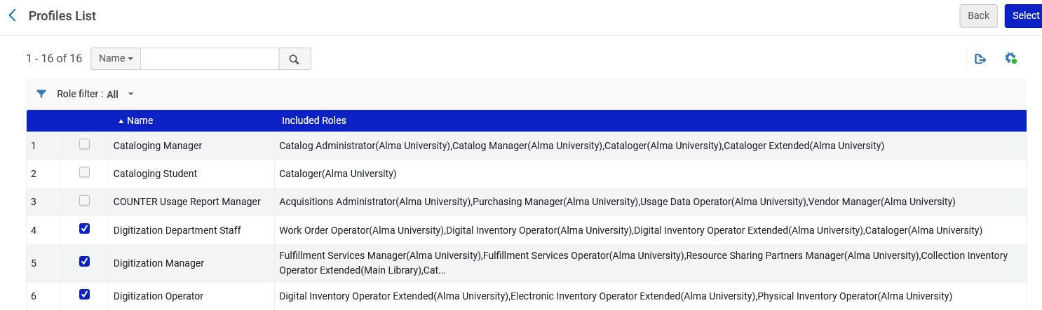
User Roles
Selecting these three profiles will automatically add all of the roles associated with the profiles to the user.

Slide 38
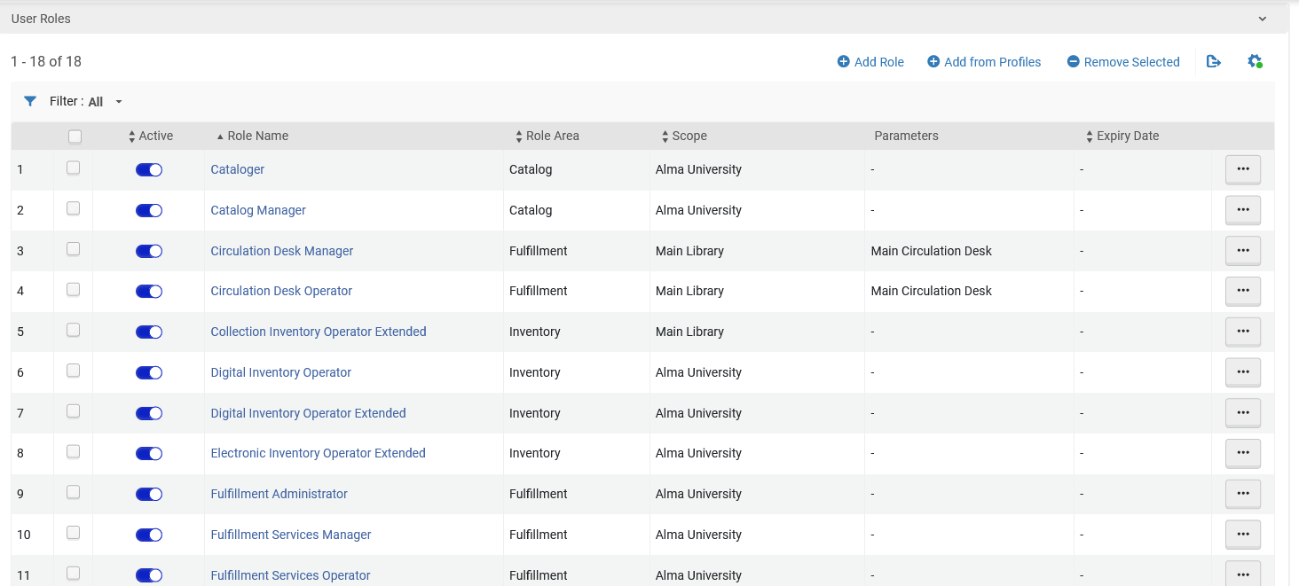
User Roles
Additional roles have been added to the user from the profiles

Slide 39
Searching for, editing and deleting users

Slide 40
Searching for, editing and deleting users
As mentioned previously in the section "The Find and Manage Users page":
The staff user arrives to the "Find and Manage Users page" either by
  Using Menu Admin > User Management > Manage Users
  Searching for a user

Slide 41
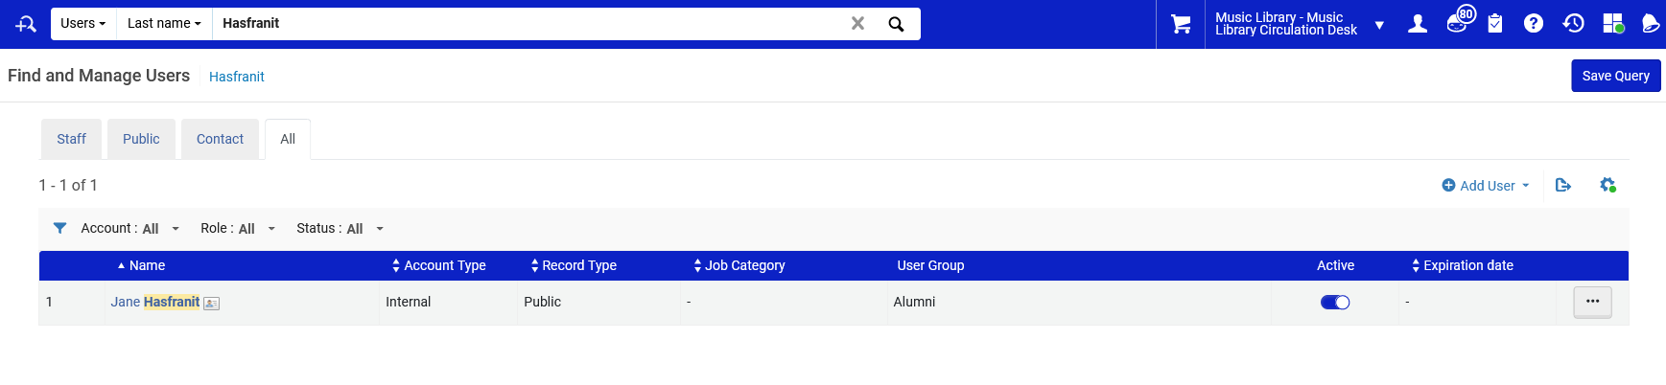
Searching for, editing and deleting users
Users can be searched for in Alma by both the simple search and the advanced search.
For example, here is a simple search for users with last name "Hasafranit".

Slide 42
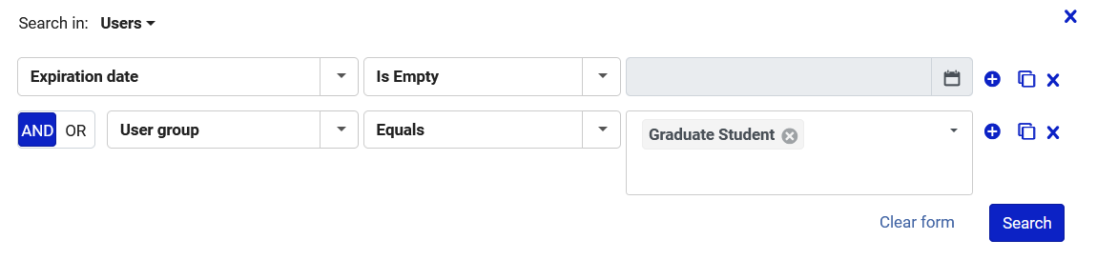
Searching for, editing and deleting users
Here is an advanced search for all users with no expiration date that have user group "Graduate Student"

Slide 43
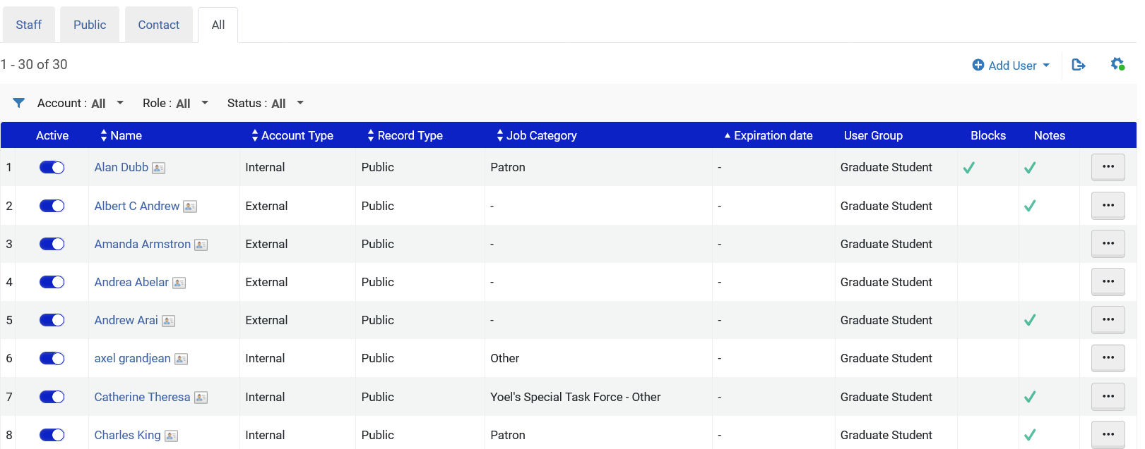
Searching for, editing and deleting users
Results are users with no expiration date with user group "Graduate Student".

Slide 44
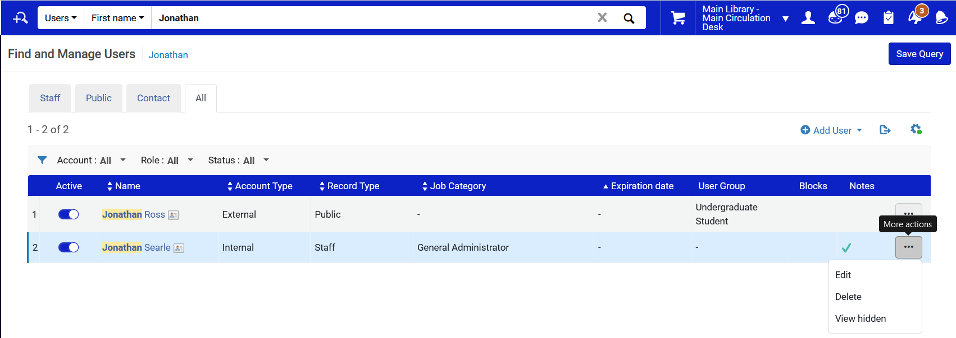
Searching for, editing and deleting users
From the search results (which is the "Find and Manage Users" page) it is possible to edit and delete users.
We will click "Edit" for this user
Note that the account type for this user is "Internal

Slide 45
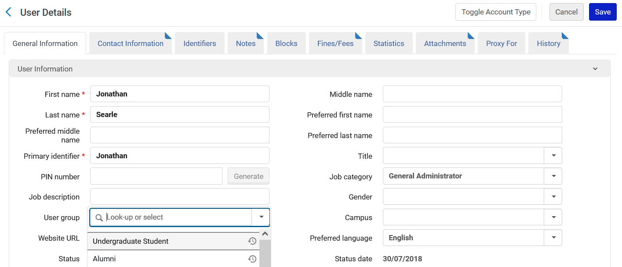
Searching for, editing and deleting users
Note that the fields are editable
Now for example we will change the field "User Group".

Slide 46
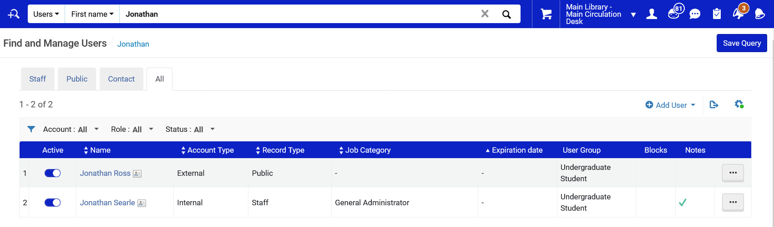
Searching for, editing and deleting users
The user group has been updated

Slide 47
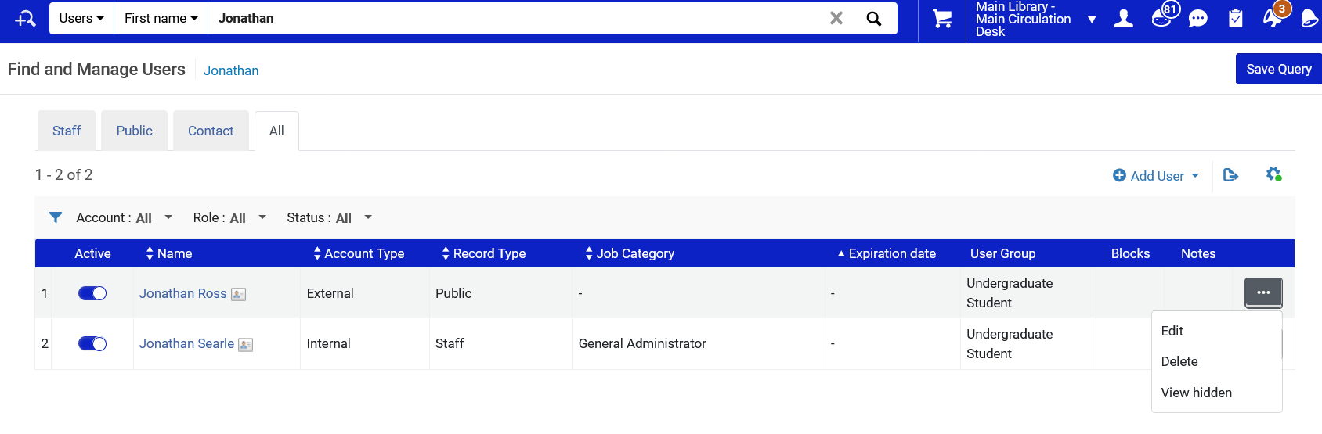
Searching for, editing and deleting users
Now we will try to edit a user with account type "External"

Slide 48
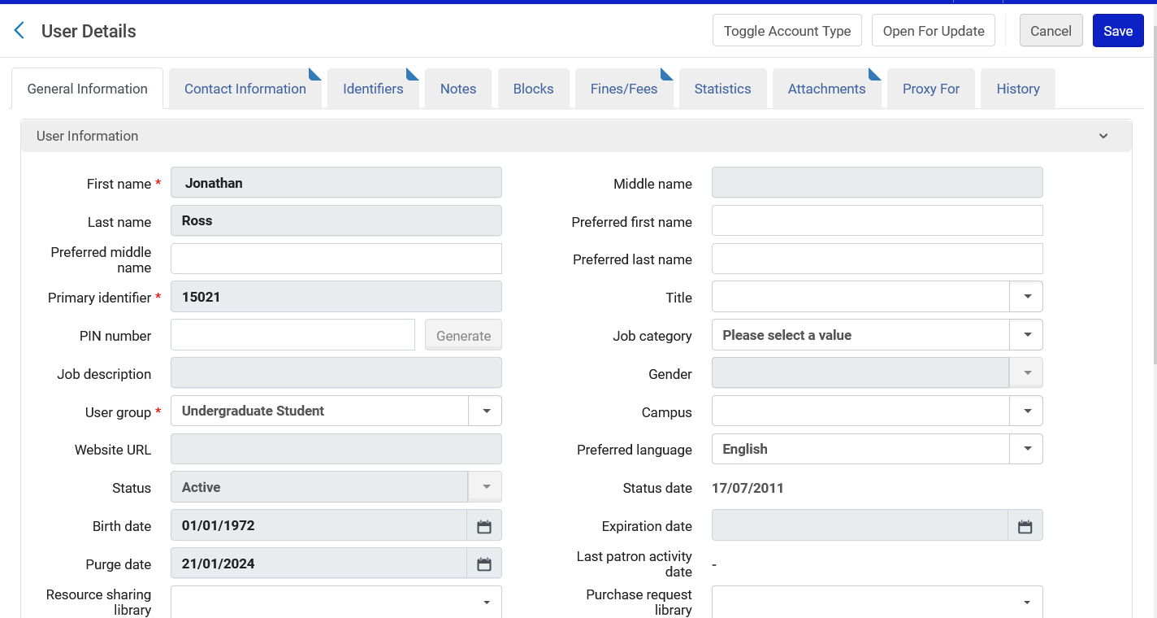
Searching for, editing and deleting users
Many of the fields are in grey (for example first name and last name) because they cannot be edited.
These fields are handled via an external system with an integration profile

Slide 49
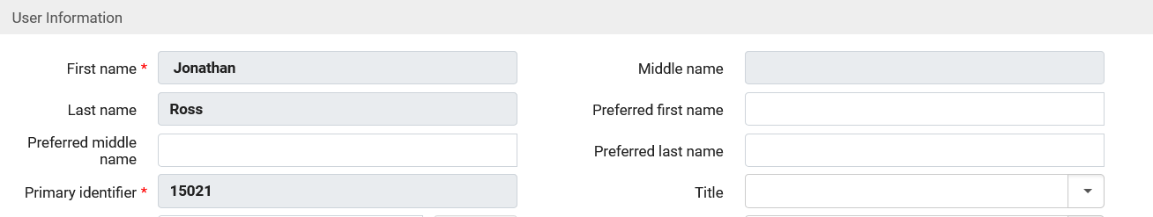
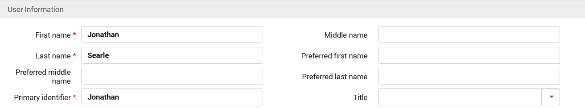
Searching for, editing and deleting users
After editing a user with account type "External"
Grey fields locked for editing
After editing a user with account type "Internal"
Fields are not locked for editing

Slide 50
Searching for, editing and deleting users
From the "Find and Manage Users" page it is also possible to delete users.
There are conditions which must be met before a user can be deleted.
For example, the user cannot have active loans or owe fines and fees.
For a full list of conditions see Deleting Users

Slide 51
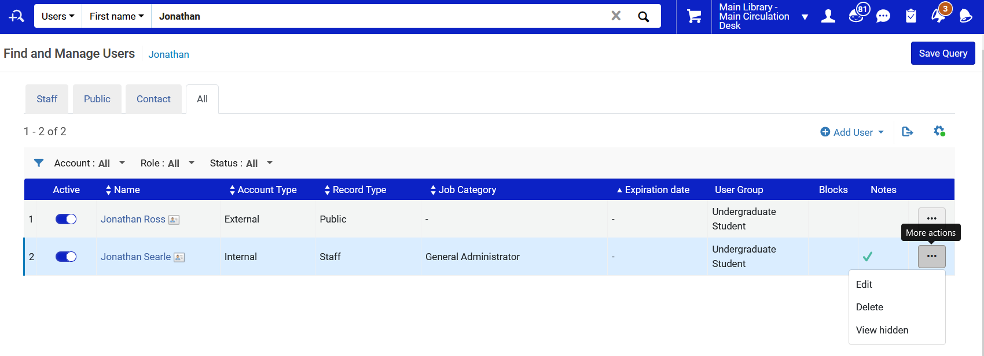
Searching for, editing and deleting users
We will now delete user Jonathan Searle

Slide 52
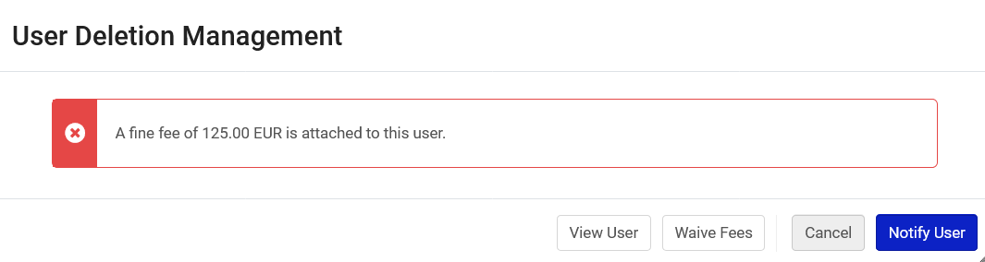
Searching for, editing and deleting users
We get a message that we cannot delete this user because he has fines.
We will waive the fees and delete him

Slide 53
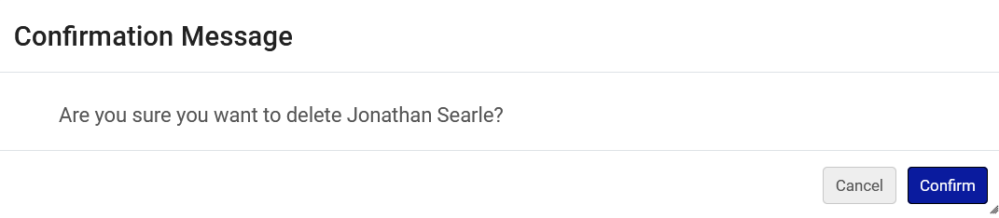
Searching for, editing and deleting users
We will confirm deletion

Slide 54
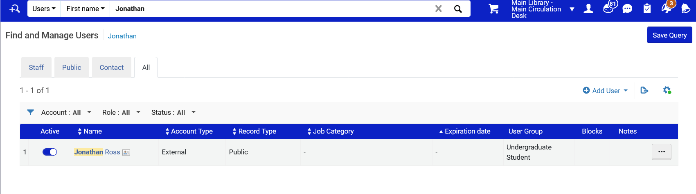
Searching for, editing and deleting users
User has been deleted

